Slide 1


Deforestation
(Fire Classification)

Slide 2

Learning Objectives
Understand Deforestation Patterns Learn how fires impact forests and why early detection matters
Master Image Classification Use AI to analyze satellite/drone images of fire-affected areas
Build & Train ML Models Develop CNN models (like ResNet) to detect fires accurately
Create Real-World Solutions Design a prototype for real-time fire alerts and monitoring
GOAL

Slide 3
Tools and Technology used
Satellite Data Sources NASA FIRMS, Sentinel-2 for real-time fire detection
AI/ML Frameworks TensorFlow/PyTorch with CNN models (ResNet, MobileNetV2)
Image Processing Tools OpenCV, GDAL for preprocessing satellite imagery
Cloud Platforms Google Earth Engine/IBM Cloud for scalable processing

Slide 4
Methodology
Data Collection Gather satellite images (NASA FIRMS, Sentinel-2) with fire/no-fire labels
Image Preprocessing Clean, normalize, and augment datasets using OpenCV/GDAL
Model Development Train CNN models (ResNet, MobileNet) with TensorFlow/PyTorch
Deployment & Monitoring Integrate model with cloud platforms for real-time fire alerts

Slide 5
Problem Statement:
"Developing an AI system to automatically detect and classify deforestation fires
from satellite imagery for faster response and forest protection."

Slide 6
Solution:
AI-Powered Detection Uses CNN models to classify fire vs. non-fire areas in satellite images
Real-Time Monitoring Processes live data from NASA/Sentinel-2 for instant alerts
Scalable Cloud Integration Deploys model on Google Earth Engine/IBM Cloud for global coverage
User-Friendly Alerts Sends notifications to authorities via dashboards or mobile apps
Git Repo Link : https://github.com/naman378/Deforestation-Detection.git

Slide 7
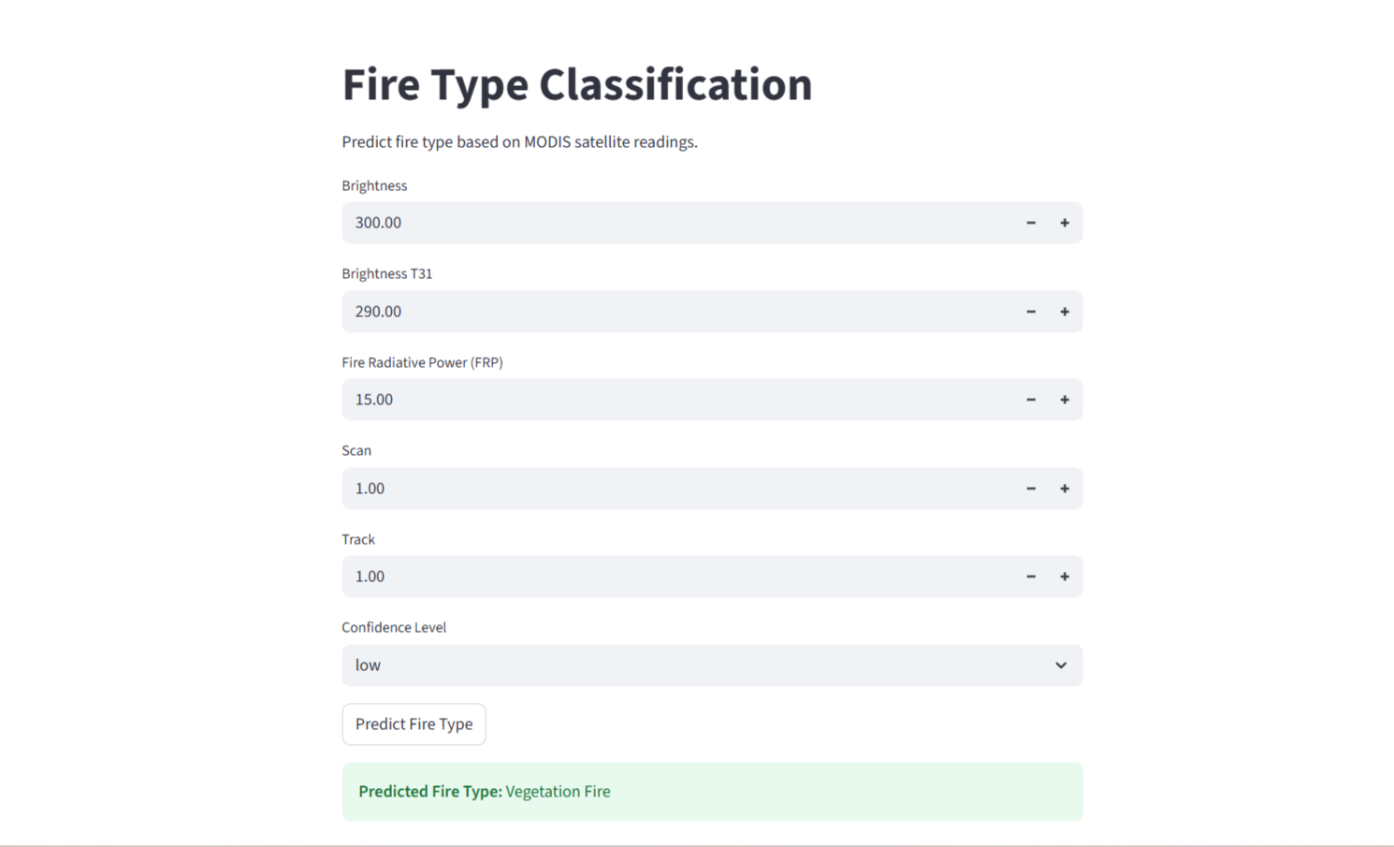
Screenshot of Output:

Slide 8
Conclusion:
"Our AI-driven deforestation fire detection system enables rapid,
accurate identification of forest fires using satellite imagery,
empowering timely interventions to protect ecosystems and biodiversity.“
Future Scope: Expand to predict fire spread patterns
Impact: Potential to reduce response time by 70%

Slide 9
Thank You.

